Slide 1
Design Presentation: Security
Owner: Sean Norman
CSA07P | 1 of 2
Session Day/Time: |  | Presenters/SMEs:
Virtual Format and Software:
Cohort / Breakout Mgmt
Objective of Session: | As a result of attending this, attendees will better be able to…
Existing Sources: | <link to any supporting content sources (if any)>
Learner Content: | <Link to draft ppt slide deck and any other materials that the attendees would be seeing or using as part of this session>
Presenter/ SME Guide Content: | <Link to any supporting materials that are just for the presenter and/or supporting SMEs>
Required Homework + name of session for HW review: | No homework or pre-required content needed for this session

Slide 2
Design Presentation: Security
Owner: Sean Norman
CSA07P | 2 of 2
Session Flow and Detailed Agenda |  | Presenter/SME: | Time
Prework | No attendee pre-work needed for this session | N/A | N/A
Session Introduction | Set context for when this process takes place | <presenter> | 3 mins
Body of the session / discussion, activities, Q&A... |  | <presenter> | 25 mins
Session Closing / Homework |  | <presenter> | 2 mins

Slide 3
Topics Covered
SQL Server Data Tools
Azure Data Studio

Slide 4
DevOps in Azure Synapse

Slide 5

Agenda
1 SQL Server Data Tools
SSDT and Visual Studio 2019
Integrate SSDT projects with Azure Repos
Deploy to target environments using Azure Pipelines
2 Azure Data Studio
Schema compare

Slide 6
SQL Server Data Tools

Slide 7
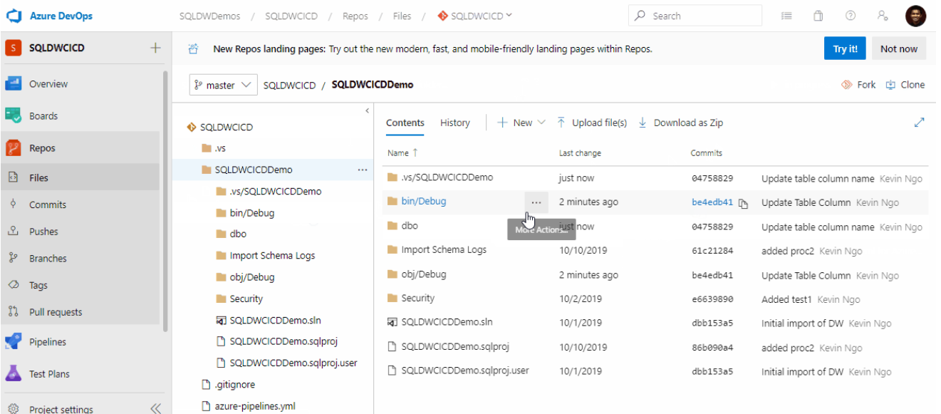
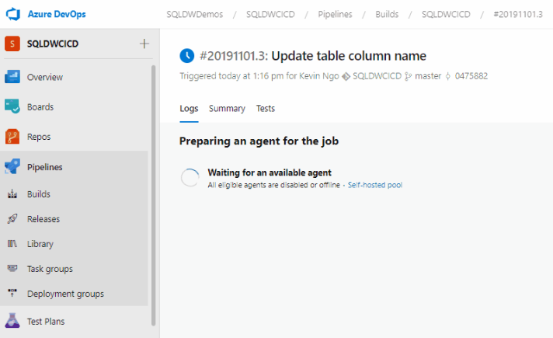
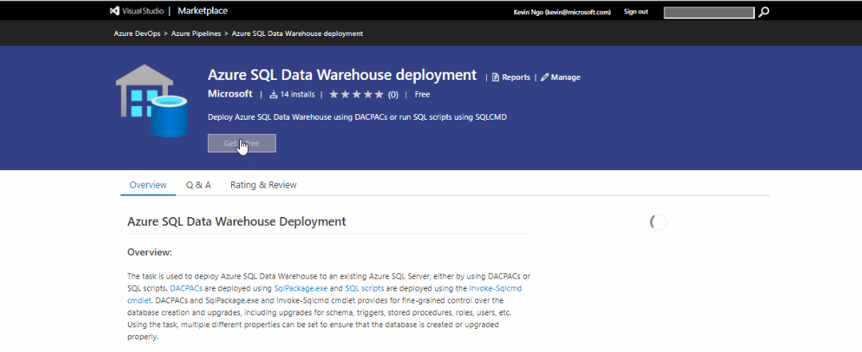





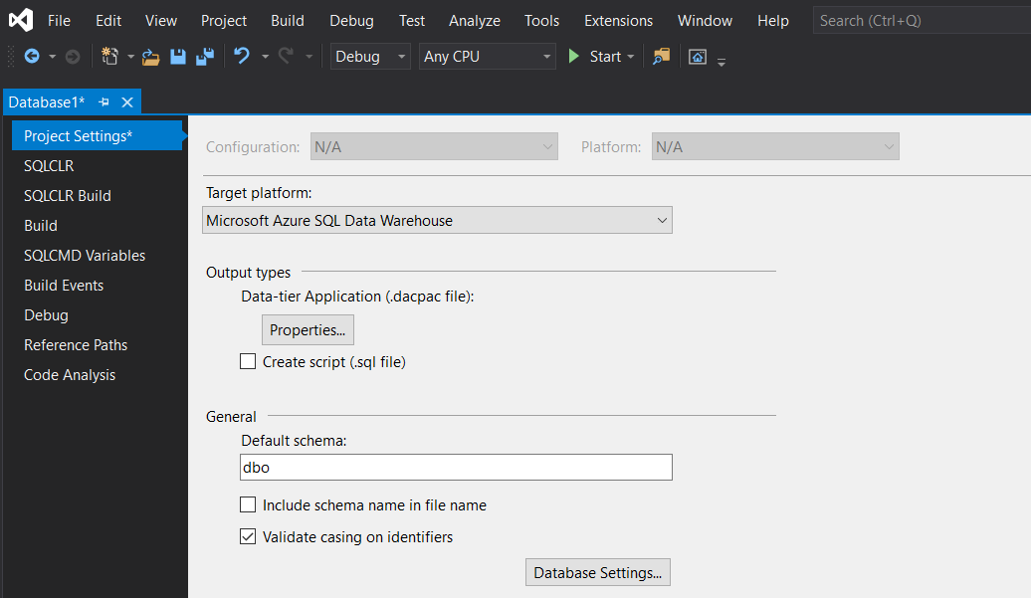
The CI/CD process for SQL Pools
Azure DevOps
Test/QA
Prod
DACPAC artifact
Continuous integration
MSBuild
Functional/perf/integration tests
Continuous deployment
SqlPackage.exe/publish task
Azure Repos
Azure Pipelines
Visual Studio
Dev
SSDT
Schema compare and delta scripts
Publish
Post/Pre-deployment scripts
---------------------------
Built-in object templates
Build – syntax and object reference validation
Tables
Views
Stored procedures
…
.sqlproj

Slide 8
Azure Data Studio

Slide 9
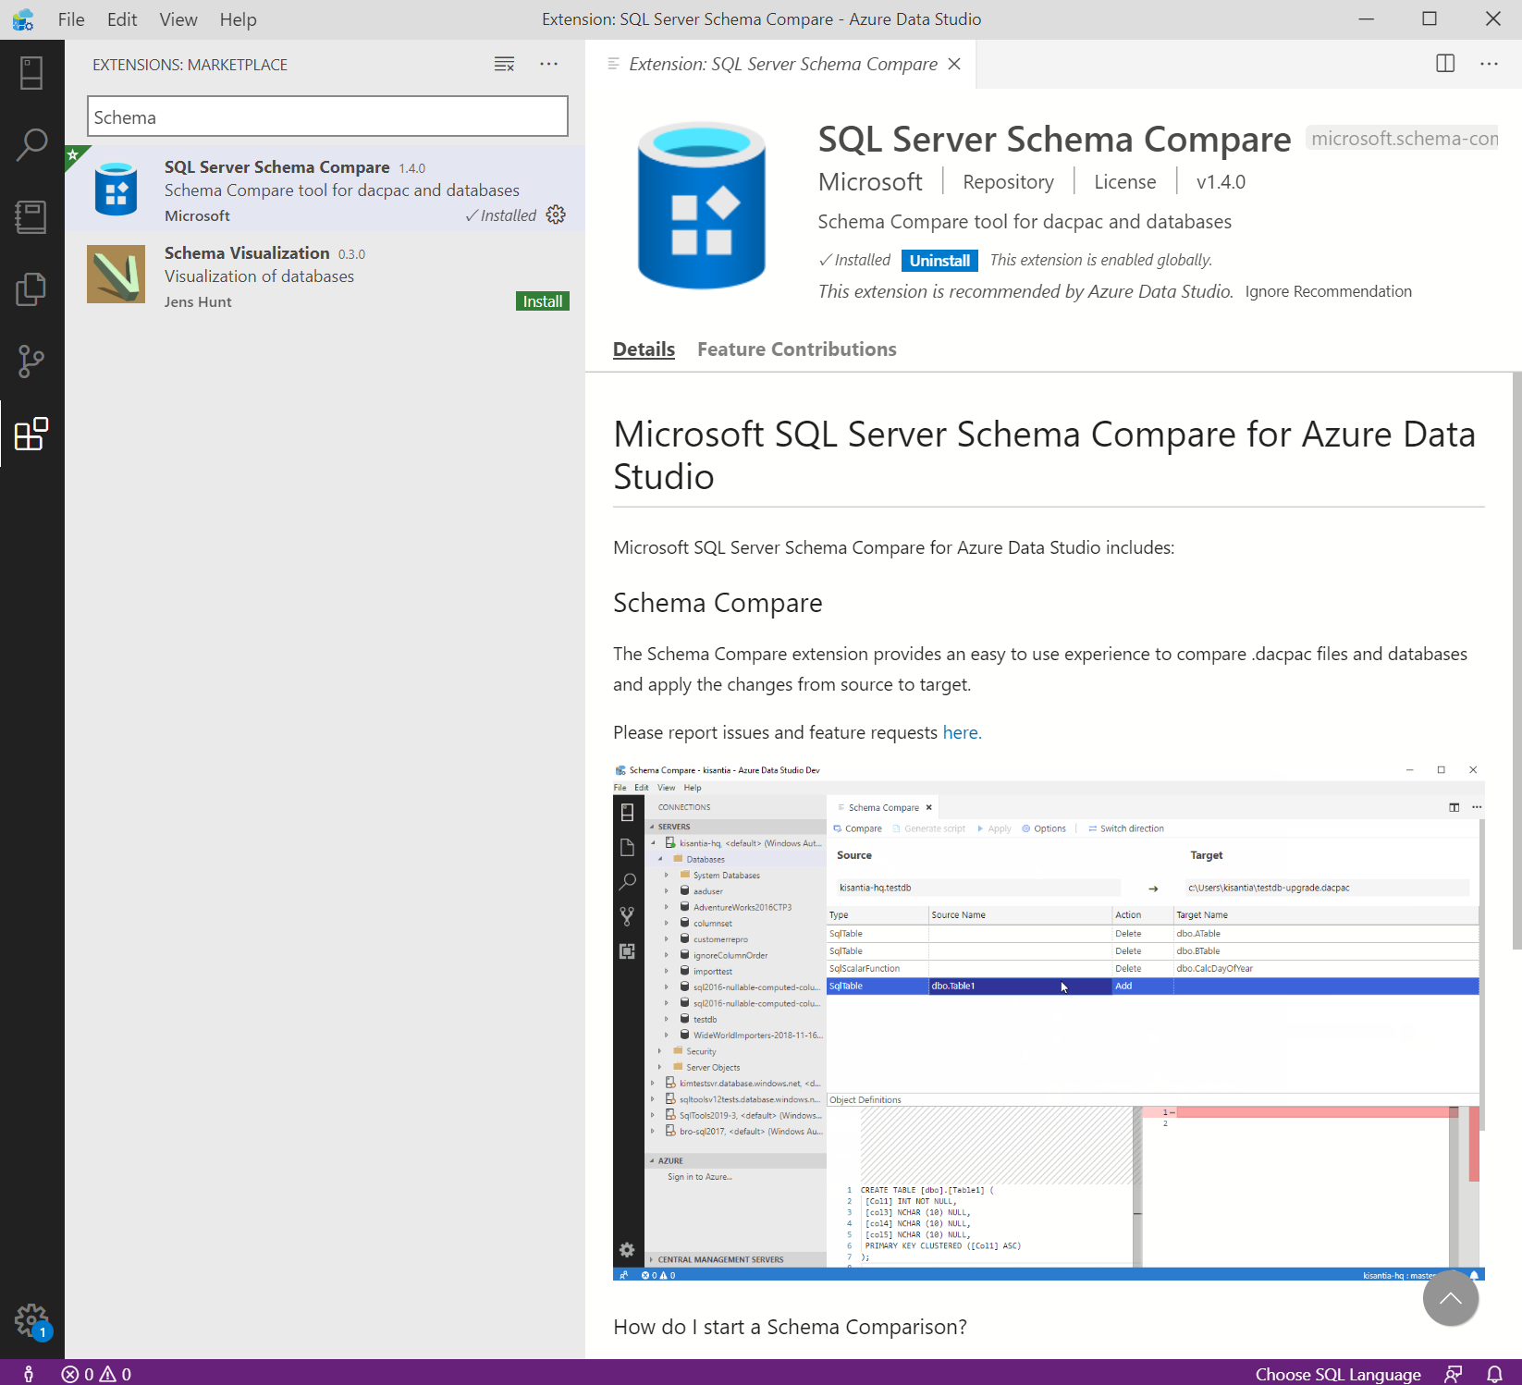
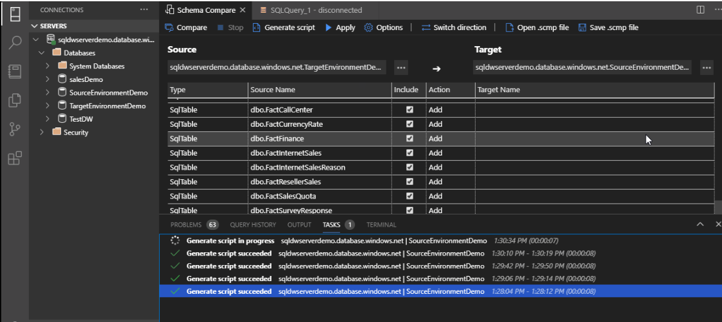
Schema compare with Azure Data Studio
Cross platform support for Schema compare

Slide 10
Thank You slide
Thank you

